Slide 1
ECC Linux workshop (intro course)
root@linux:~# apt-get remove windows

Slide 2
What is linux?
What Is Linux?
From smartphones to cars, supercomputers and home appliances, home desktops to enterprise servers, the Linux operating system is everywhere.
Linux has been around since the mid-1990s and has since reached a user-base that spans the globe. Linux is actually everywhere: It’s in your phones, your thermostats, in your cars, refrigerators, Roku devices, and televisions. It also runs most of the Internet, all of the world’s top 500 supercomputers, and the world’s stock exchanges.
But besides being the platform of choice to run desktops, servers, and embedded systems across the globe, Linux is one of the most reliable, secure and worry-free operating systems available.

Slide 3
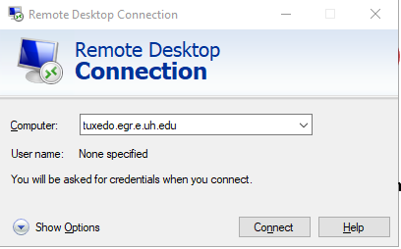
HOW TO LOGIN
Open Remote Desktop Connection (RDP) from the Windows Start menu and enter the hostname:
tuxedo.egr.e.uh.edu

Slide 4
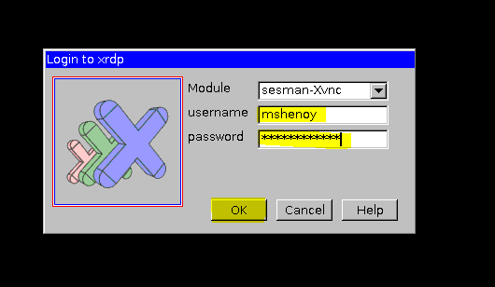
How to login
Use Ecc Unix/Cougarnet Account for RDP login

Slide 5
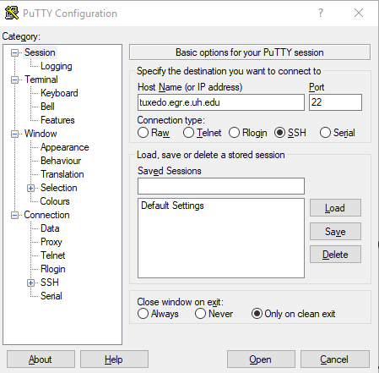
How to login
Second method for TERMINAL (no gui) use only.
Download and install putt
Open PUTTY app from Windows
Type the hostname or IP of destination
Port is always 22
Enter ECC-UNIX user ID, and password
If successful, user command prompt will be shown “Click yes when prompt with security banner”

Slide 6
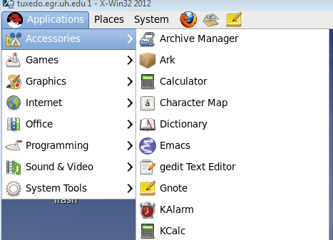
NAGIVATE THE GUI
Applications
Accessories
word processing
System tools
Command line (terminal)
Places
Home folder
Subdirectories
Search for files
System
Preferences
Administration Utilities
System Documentation

Slide 7
Shell command syntax
Command syntax and arguments are DIFFERENT for each and every shell command
[eccspprt@tuxedo] ~$ command OPTIONS file file2
Example:
[eccspprt@tuxedo] ~]$ ls -la file_name
- Will display all files in the current working directory with a “long listing format”
perm user group modified file_name

Slide 8
Basic SHELL COMMANDS
Navigation:
ls – list directory contents
ls –l - view files and permissions
pwd – print, current working directory
cd – Change directory

Slide 9
Basic SHELL COMMANDS
Copying, Moving, and Deleting
mkdir – create a directory
mkdir directory path
touch – make basic text files
touch <file name>
cp – copy files and directories
cp <file source> <file destination>
mv – move or rename file
mv <file source> <file destination>
rm – delete a file (can be destructive)
rm <file path>
rmdir – delete directory (empty directory)
rmdir <file path>

Slide 10
Basic shell commands
Search commands:
find – search for files
Find <source> -name <name of file or directory> -print
Documentation:
man – manual pages
man <command>
Change File Permissions:
chown – change file owner and group
chown owner:group <file path>
chgrp <groupname> <file path>

Slide 11
Basic shell commands
System commands:
top - show current processes that are running
df –h - show the file system disk space usage
w - show users currently logged on to the system
uptime - show date, load average, and # of users
uname –a :- show current OS version and computer hostname
Network Statistics:
Ifconfig - show IP address information
netstat –rn - show IP routing information

Slide 12
Basic Shell commands
OTHER COMMANDS
du –sh [file/directory] - estimate file space usage
diff [file1] [file2] - compare files line by line
tar –cvf [archive.tar] [files or directory] - create archive of files also with compression
tar –xvf [tar_file.tar] – decompress and expand archived files
tar –czvf [archive.tar.gz] [files and or directory] – create archive with compression
history – Shows previously used command. Command can also be repeated by running “!number”

Slide 13
Downloading external Files
What is the wget command? The wget command is a command line utility for downloading files from the Internet. It supports downloading multiple files, downloading in the background, resuming downloads, limiting the bandwidth used for downloads and viewing headers
Example for the “wget” command:
command link

Slide 14
Text Editors
NANO ( simple command line text editor)
nano <file>
VIM (command line text editor)
vim <file>
GEDIT or EMACS (Terminal Editor with GUI)
gedit <file>
emacs <file>

Slide 15
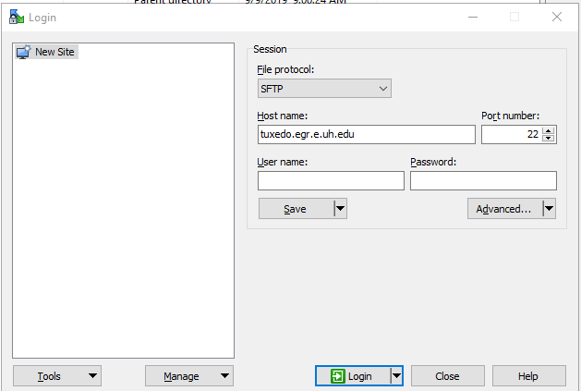
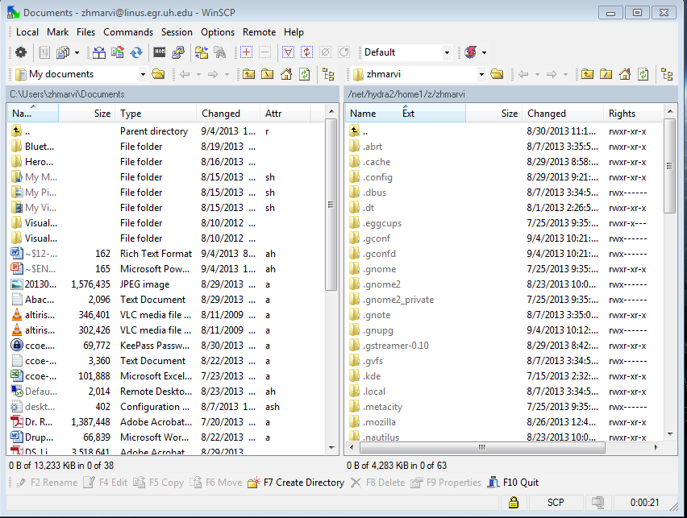
file Transfer
WinSCP:
WinSCP (Windows Secure Copy) is a free and open-source SFTP, FTP, WebDAV, Amazon S3 and SCP client for Microsoft Windows. Its main function is secure file transfer between a local and a remote computer.
Login
Open WinSCP program
Enter user credentials & hostname then click login
Transfer files from Windows to Linux and vice versa
Download WinSCP from
- https://winscp.net/eng/download.php

Slide 16
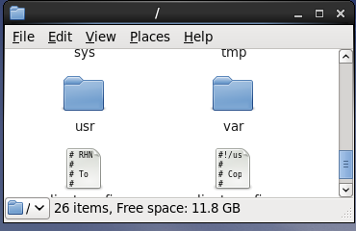
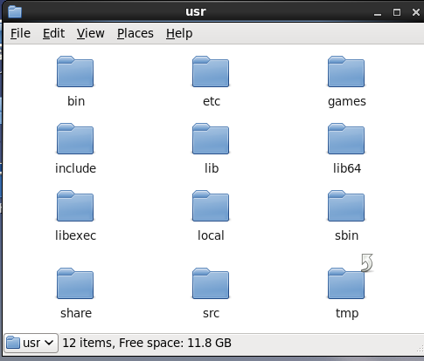
Class software location
Software such as MATLAB, Abacus, Fluent, Cadence, Comsol, etc… will be located in the following directory:
- Location: /usr/local

Slide 17
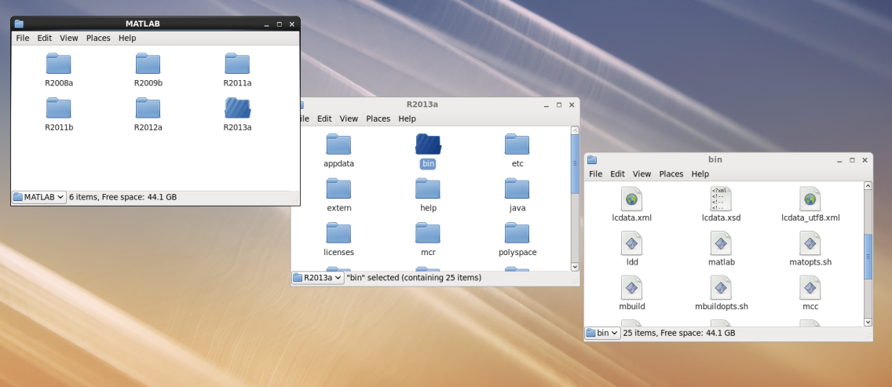
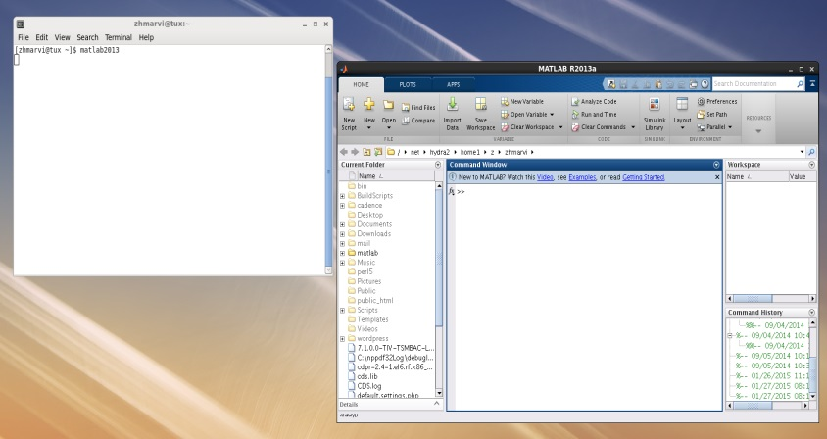
matlab
Location of MATLAB Software folder:
- /usr/local/MATLAB
To run application using GUI:
Click “Computer” -> “Filesystem” -> “usr” -> “local” -> “MATLAB” -> “R2019a” -> “bin” -> “matlab”
Alternative Way to launch:
- type: “matlab” in the terminal

Slide 18
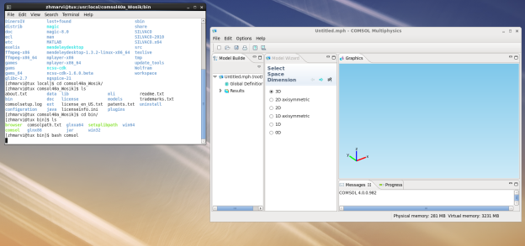
comsol
Location of Comsol software executable
/usr/local/comsol40a_Wosik/bin/comsol
Create a command path in your home .bashrc file
export PATH=$PATH:/usr/local/comsol40a_Wosik/bin/
Save .bashrc file
Type $ source .bashrc
TO CHECK YOUR CONFIGURATION:
Check you path with $ echo $PATH
Also check the path location of a shell command using which
Ex. $ which comsol

Slide 19
cadence
Software Location:
/usr/local/Cadence
Using your favorite text editor…
Edit ~/.login
Add lines:
#Cadence Calp path
set path=($path /usr/local/bin /usr/local/calp)
source /usr/local/calp/nlogin
Save file
Edit ~/.cshrc
#Cadence Virtuoso Path
alias virtuoso "/usr/local/Cadence/ic/tools/dfII/bin/virtuoso &"
setenv PATH ${PATH}:/usr/local/Cadence/ic/tools/dfII/bin
setenv PATH ${PATH}:/usr/local/Cadence/tools/bin
set path=($path /usr/local/bin /usr/local/calp)
source /usr/local/calp/ncshrc
Save file
Run virtuoso: in the shell
Type:
$ tcsh
$ source ~/.login
$ virtuoso &
MUST BE IN A X11 (remote graphical) SESSION TO RUN THIS PROGRAM

Slide 20
Silvaco
Location of program is located in /usr/local/SILVACO.x64
Users can set the path to run the program in there home directory.
Set your path in your home folder .bashrc file.
Using (vim,nano) text editor, enter the following line in your profile:
export PATH=$PATH:/usr/local/SILVACO.x64/bin/
Save .bashrc file
Type $ source .bashrc
Check your configuration:
Check path with $ echo $PATH
Also check the path location of a shell command using which
Ex. $ which deckbuild

Slide 21
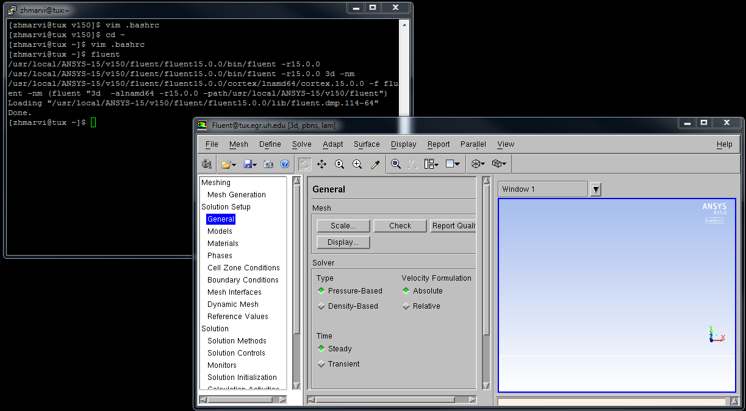
Fluent
Location: : /usr/local/ANSYS-15/v150/fluent/bin/fluent
Run Fluent from the CLI (easy way)
In home .bashrc file, add
##Fluent Path
export PATH=$PATH:/usr/local/ANSYS-15/v150/fluent/bin/
Save…
Type: $ fluent

Slide 22
HELP & Request
For help with your ECC-UNIX account profiles and or any issues related to our engineering Linux servers, please make requests to mshenoy@uh.edu
If a change is needed on a faculty research server or computer. Please send an email to your faculty advisor/professor for approval. Always ask the faculty advisor to make technical request instead of going directly to the IT administration.

