Slide 1
ECC Linux workshop (intermediate course)

Slide 2
WHAT WILL BE COVERED
Input, Output and Pipes
Processes
Compiling Unix Software Packages
Symbolic and Hard Links
Environment Variables
Security & ECC Policies

Slide 3
cougarnet authentication
COUGARNET ACCOUNT PASSWORDS WILL BE USED TO LOGIN TO ALL ENGINEERING LINUX SYSTEMS
NEW USERS WILL STILL NEED TO CREATE A ECC-UNIX ACCOUNT USERNAME
ALL ACCOUNT PASSWORDS WILL HAVE TO BE RESET BY UofH CENTRAL IT.

Slide 4
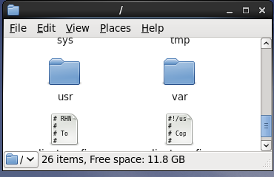
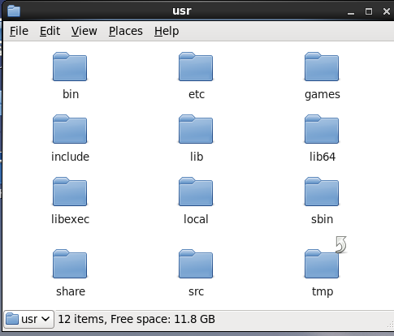
Class software location
Location: /usr/local
Software: MATLAB, Abacus, Fluent, Cadence, Comsol, etc…

Slide 5
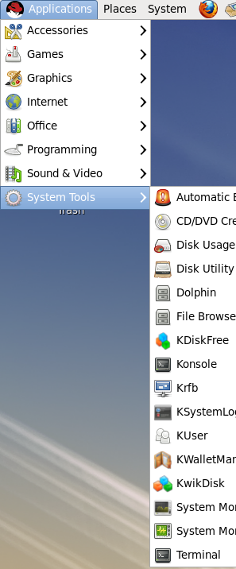
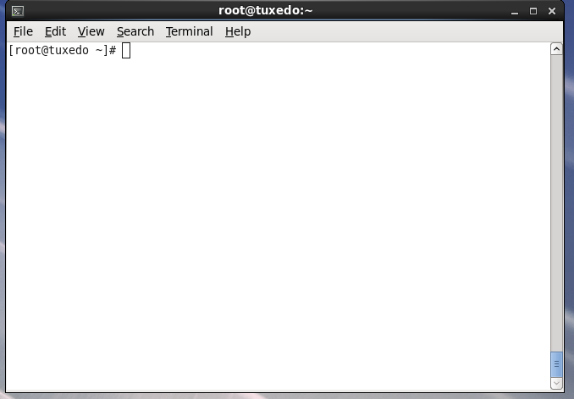
ACCESS THE COMMAND LINE PROMPT
Applications → System tools → Terminal
Fully text based command prompt
Shell prompt
[ username@<hostname> <current working directory>] $

Slide 6
USING SIMPLE SHELL COMMANDS
Navigation:
ls – list directory contents
ls –l - view files and permissions
pwd – print, current working directory
cd – change directory
cd <directory path>
Ex. (to go to user home directory)
[user]$ cd /home/user or cd ~
Copying, Moving, and Deleting
cp – copy files and directories
cp <file source> <file destination>
mv – move or rename file
mv <file source> <file destination>
touch – make basic text files
touch <file name>
mkdir – create a directory
mkdir <directory file path>
rm – delete a file (can be destructive)
rm <file path>
rmdir – delete directory (empty directory)
rmdir <file path>

Slide 7
SHELL COMMANDS (continued)
Search commands:
find – search for files
Find <sourse directory> -name <name of file or directory> -print
Documentation:
man – manual pages
man <command or application>
Change File Permissions:
chown – change file owner and group
chown owner:group <file path>
chgrp <groupname> <file path>
System commands:
top – show current processes that are running
df –h: show the file system disk space usage
w : show users currently logged on to the system
uptime : show date, load average, and # of users
uname –a : show current OS version and computer hostname
Network Statistics
ifconfig: show IP address information
netstat –rn : show IP routing information

Slide 8
REMOTE ACCESS
SSH – Secure Shell client
A program used for “shell” access to a remote system.
Login using UNIX/Linux terminal (shell), or through “PUTTY”
Use ECC UNIX account info to login
PUTTY (for Windows Users)
Free application
Allows shell logins from a windows desktop

Slide 9
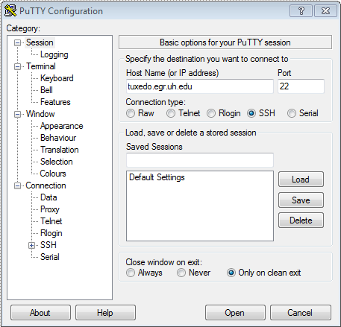
Remote access (cont)
SSH from PUTTY:
Open PUTTY app from Windows
Type the hostname or IP of destination
Port is always 22
Enter ECC-UNIX user ID, and password
If successful, user command prompt will be shown
SSH from another terminal (shell):
Type command: ssh <username>@<hostname>

Slide 10
INPUT/OUTPUT REDIRECTION (PIPING)
Programs can output to other programs called “piping”
“program_a | program_b”
program_a’s output becomes program_b’s input
“program_a > file.txt”
program_a’s output is written to a file called “file.txt”
“program_a < input.txt”
program_a gets its input from a file called “input.txt”

Slide 11
PROCESSES
A process is an executing program identified by a unique PID.
In Linux, every process has a unique process identifier (ID) associated to it.
A process ID (PID) is a number which is uniquely assigned as soon as the process is created.
A process may be in the foreground or in the background. Backgrounding a long process has the effect that the UNIX prompt is returned immediately.

Slide 12
Process state
There are 5 states a process can be in
Task_Running
Task_Interruptible
Sleeping until some condition is true
Task_uninterruptible
device driver probing for a certain hardware state
Signals to this process leaves it unchanged
Task_Stopped
Task_Zombie

Slide 13
Command: kILL
To terminate a process use “kill”

Slide 14
COMMAND : GREP
To search files in a directory for a specific string use “grep”

Slide 15
Software installation
Software for Linux can consist of:
Binary files precompiled to run on certain hardware architectures
Source code, which must be compiled before use
Typically distributed in tarball format
Package manager: system that defines standard package format
Used to install, query, and remove packages
Red Hat Package Manager (RPM): most common package manager used by Linux systems today

Slide 16
Compiling software packages from tar file
Uncompress the tar file
$ tar -zxf file.tar.gz
Change directory
$ ls
$ cd path-to-software/
Build and install software
$ ./configure
$ make
$ make install

Slide 17
Compiling software packages cont’d
./configure will configure the software to ensure that system has necessary functionality and libraries to successfully compile the package.
Make will compile all source files into executable binaries.
Finally, make install will install the binaries and supporting files into appropriate locations

Slide 18
filesystem link
A link is a pointer to a file.
This pointer associates a file name with a number called an i-node number
An i-node is the control structure for a file (on a UNIX/Linux file system)
If two file names have the same i-node number, they are links to the same file

Slide 19
filesystem link cont’d
There are two kinds of links:
1. Hard Links
2. Soft or Symbolic Links

Slide 20
Hard links
Hard link is a reference to the physical data on a file system
More than one name can be associated with the same physical data
Hard links can only refer to data that exists on the same file system
You can not create hard link to a directory

Slide 21
Display hard links info
Create a new file called “myfile”
Run the command “ls -il” to display the i-node number and link counter
38753 -rw-rw-r-- 1 uli uli 29 Oct 29 08:47 myfile
^ ^
|-- inode # |-- link counter (one link)

Slide 22
Display hard links info
Create a 2nd link to the same data:
ln myfile mylink
Run the command “ls -il”:
38753 -rw-rw-r-- 2 uli uli 29 Oct 29 08:47 myfile
38753 -rw-rw-r-- 2 uli uli 29 Oct 29 08:47 mylink
^ ^
|-- inode # |--link counter (2 links)

Slide 23
Removing a hard link
When a file has more than one link, you can remove any one link and still be able to access the file through the remaining links.
Hard links are a good way to backup files without having to use the copy command!

Slide 24
Symbolic links
Also Known As (a.k.a.): Soft links or Symlinks
A Symbolic Link is an indirect pointer to a file – a pointer to the hard link to the file
You can create a symbolic link to a directory
A symbolic link can point to a file on a different file system
A symbolic link can point to a non-existent file (referred to as a “broken link”)

Slide 25
Symbolic links
To create a symboic link to the file “myfile”, use
ln -s myfile symlink or
ln --symbolic myfile symlink
[uli@seneca courses] ls -li myfile
44418 -rw-rw-r-- 1 uli uli 49 Oct 29 14:33 myfile
[uli@seneca courses] ln -s myfile symlink
[uli@seneca courses] ls -li myfile symlink
44418 -rw-rw-r-- 1 uli uli 49 Oct 29 14:33 myfile
44410 lrwxrwxrwx 1 uli uli 6 Oct 29 14:33 symlink -> myfile
Different i-node
File type: (symbolic link)
Link counter: (1 link)

Slide 26
Properties of symbolic links
The i-node number is different from the pointer to file
The link counter of the new symbolic link file is “1”
Symbolic link file does not affect the link counter of the pointed to file
The type field of symblic file contains the letter “l”
The symbolic link file and the pointed to file have different status information (e.g. file size, last modification time etc.)

Slide 27
Creating symbolic link directory
The syntax is the same as linking to a file
ln -s target_directory link_directory
ln --symbolic target_directory link_directory
[uli@seneca week8]$ ls -li
38766 drwxrwxr-x 7 uli uli 168 Oct 29 13:32 courses
[uli@seneca week8]$ ln courses mydir
ln: `courses': hard link not allowed for directory
[uli@seneca week8]$ ln -s courses mydir
[uli@seneca week8]$ ls -li
38766 drwxrwxr-x 7 uli uli 168 Oct 29 13:32 courses
44417 lrwxrwxrwx 1 uli uli 7 Oct 29 15:41 mydir -> courses

Slide 28
Directory listing
To display the contents in a directory, we normally use the command “ls -l directory_name”
Compare the following
[uli@seneca week8]$ ls -l mydir
lrwxrwxrwx 1 uli uli 7 Oct 29 15:41 mydir -> courses
[uli@seneca week8]$ ls -l courses
drwxrwxr-x 2 uli uli 72 Oct 29 11:15 ica101
drwxrwxr-x 2 uli uli 72 Oct 29 11:16 ios110
drwxrwxr-x 2 uli uli 120 Oct 29 11:20 to_do
drwxrwxr-x 2 uli uli 72 Oct 29 11:14 uli101

Slide 29
Delete link to a directory
To delete a link to a directory, simply use the “rm” command:
[uli@seneca week8]$ ls -l
drwxrwxr-x 7 uli uli 168 Oct 29 13:32 courses
lrwxrwxrwx 1 uli uli 7 Oct 29 15:41 mydir -> courses
[uli@seneca week8]$ rm mydir
[uli@seneca week8]$ ls -l
drwxrwxr-x 7 uli uli 168 Oct 29 13:32 courses

Slide 30
ENVIRONMENT VARIABLES
set command: Lists environment variables and current values
echo command: View contents a specified variable
echo $SHELL
echo $HOSTNAME

Slide 31
Environment variables (cont’d)

Slide 32
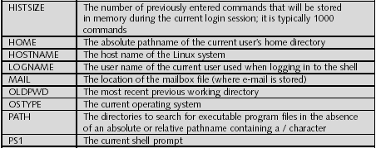
Environment variables (cont’d)

Slide 33
Environment files
Common BASH shell environment files (in order they are executed):
/etc/profile
~/.bash_profile
~/.bash_login
~/.profile
Hidden environment files allow users to set customized variables

Slide 34
Contact information
For help with your ECC-UNIX account profiles and or any issues related to our engineering Linux servers, please make requests to mshenoy@uh.edu
Undergrad and or Graduate Students -
If a change is needed on a faculty research server or computer. Please send an email to your faculty advisor/professor for approval. Always ask the faculty advisor to make technical request instead of going directly to the IT administration.
Please follow this procedure so that your change request may be processed without delay.

